Slide 1
Panel Debate 4
Managing Data Protection and Cybersecurity in healthcare

Slide 2
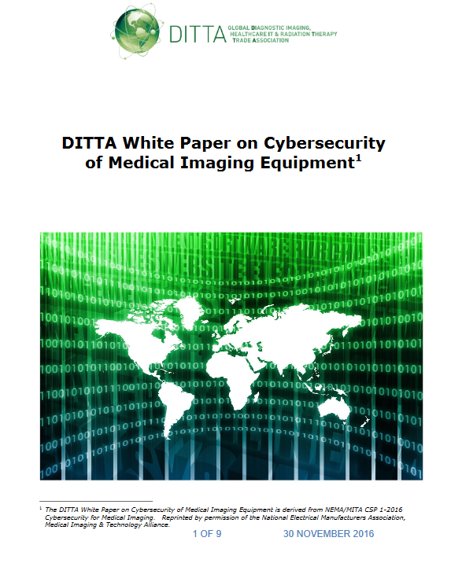

COCIR Relevant Activities
DITTA White Paper on Cybersecurity of Medical Imaging Equipment, Nov 2016
http://globalditta.org/fileadmin/user_upload/Level_home/Press_releases/2016/DITTA_Cybersecurity_paper_29_Nov._2016_final_clean.pdf
Beyond the Hype of Blockchain in Healthcare, Dec 2017
http://www.cocir.org/uploads/media/17069_COC_Blockchain_paper_web.pdf

Slide 3
Speakers
Despina Spanou, Director for Digital Society, Trust and Cybersecurity, DG Connect, European Commission
Erik Jylling, Executive Vice President, Health Politics at Danish Regions
Petra Wilson, Senior Advisor at FTI Consulting EU/ Managing Director Health Connect Partners
Olivier Joffray, COCIR Lead member in Digital Health and Head of Head of GDPR compliance at IDEMIA

Slide 4
Questions for Discussion GDPR (1/2)
Trust, which is not created by compliance alone and without which there is always an underperformance in data-sharing.
The new ethic of data donation and data collectives in the 21st century.
How are companies preparing for GDPR compliance in the context of privacy by design / consent management / revision of data processing contracts and extended liability, what challenges are they encountering and how are they addressing them?
ePrivacy Regulation and good law-making

Slide 5
Questions for Discussion Cybersecurity (2/2)
Cyber threats are constantly evolving, how can we ensure that risk-mitigation tactics are kept up-to date?
How can we build a shared-responsibility cybersecurity culture between healthcare providers and industry?
Can we build sandboxes to pilot what works in Health as we are doing for the big money in FinTech? (for instance, assess how blockchain could be used in healthcare and have a better understanding of what could be the regulatory, technical and organisational challenges)
Will the measures envisaged in the European Cybersecurity Act help to build the necessary cybersecurity capabilities in Europe and centrally coordinating the necessary standards to avoid fragmentation of the digital single market?

